Slide 1
Report on Breast Cancer Prediction using Logistic Regression
Prepared by Shakil Ahammed

Slide 2

Introduction
We will be working with the Breast Cancer dataset, which contains some very detailed measurements of cells. Along with each observation of measurements, we have the diagnosis of the cell (malignant or not).
Our goal is to train a model that will be able to predict whether or not a given cell is malignant given only its measurements.

Slide 3
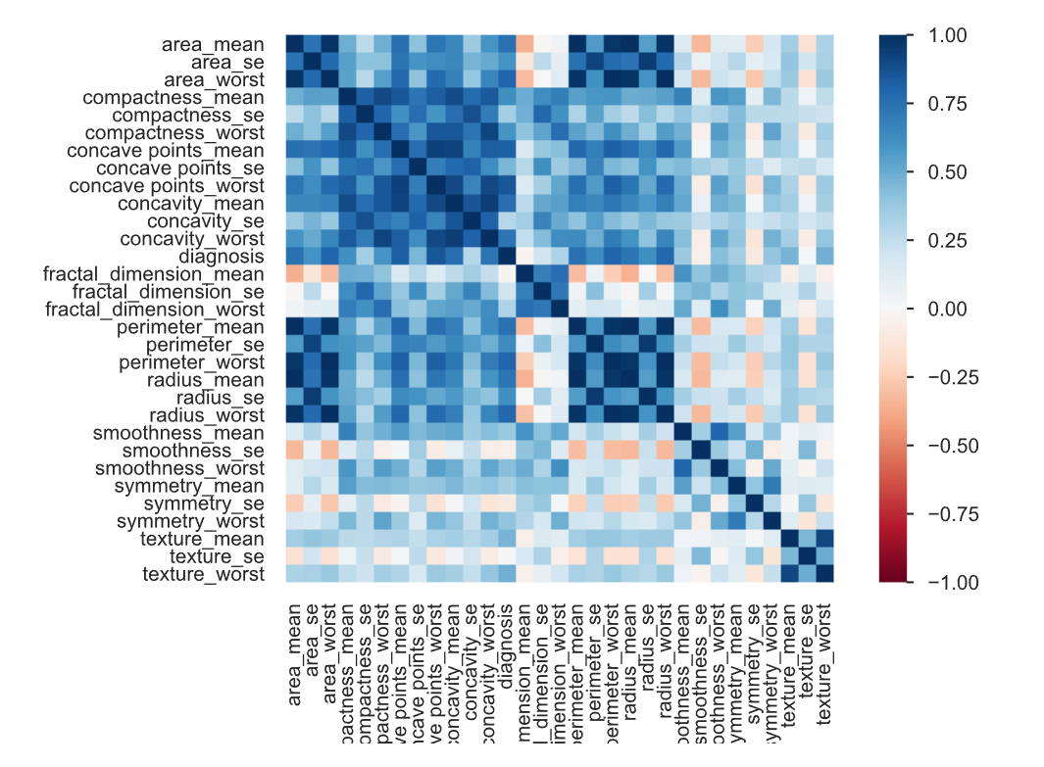
Insights
Correlation between columns.

Slide 4
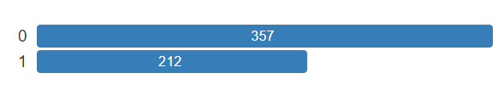
In diagnosis column, M(Malignant)= 1, B(Benign)= 0. Most cases are Benign(357).

Slide 5
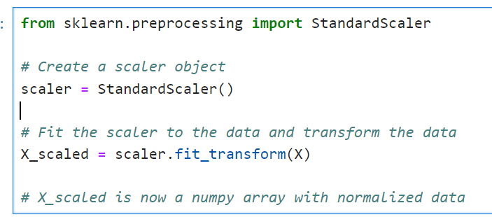
Normalize the data
The data is not yet normalized. This can be a problem, because the units of our variables are not necessarily in the same units. Also, there might be some outliers that could cause our model to perform badly.
What we do in these cases is normalize the data before feeding it into our model. This will improve the performance of our machine learning algorithm.

Slide 6
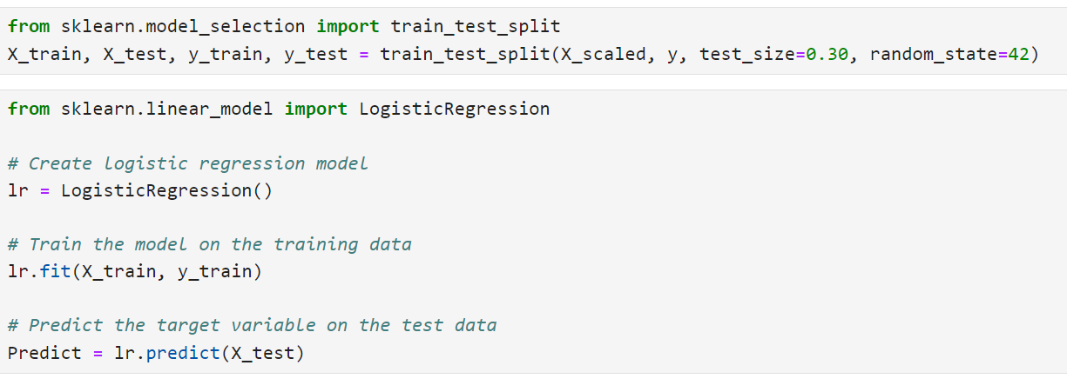
We then split the dataset into a training set and a testing set. Then create a Logistic Regression Model.

Slide 7
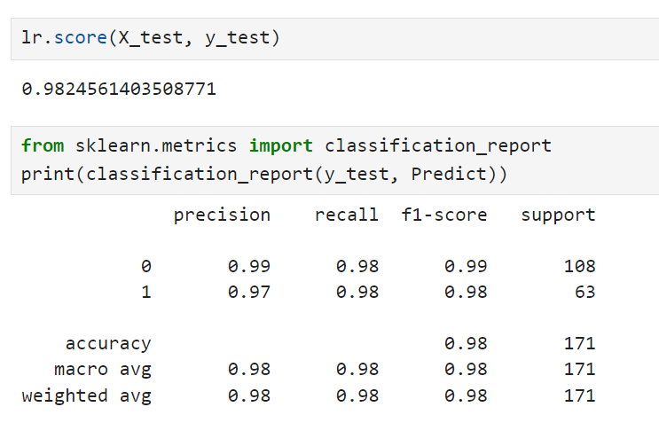
Evaluate the model
we have trained a logistic regression model to predict the target variable using a dataset of input features. As you can see here, after training the model on the training set and evaluating its performance on the test set, we achieved a final accuracy of 0.98. This is a strong performance and indicates that the model is able to make accurate predictions on new, unseen data.

Slide 8
Conclusion
We have finished our analysis. We have used the data from the open dataset Breast Cancer in order to build a model that will predict if a given cell is malicious or not given certain measurements of its nucleus. This model, now that it is trained, can, evidently, be extremely useful to perform punctual analysis on given cells for a hospital.
However, since the model is easily callable in a python function to make predictions, this kind of model can easily be added to a server technology such as Flask and serve a front-end application that doctors can use.
For example, we could build an interface where a doctor inputs some measurements that she has performed and the model would output if the cell is malicious or not. Or maybe, a more realistic use of this model could be to connect the backend application to a machine that takes a sample of tissue, measures all the cells and the performs a diagnosis.
By using python, the API of such an application would extremely minimalist, and all we did to save the lives of people was train a logistic regression model on the hospital's data.

